Slide 1
Process Synchronization
Background
The Critical-Section Problem
Synchronization Hardware
Semaphores
Classical Problems of Synchronization
Monitors
Synchronization in Solaris 2 & Windows 2000

Slide 2
Process cooperation and synchronization
Process Synchronization
  …mechanisms to ensure the orderly execution of cooperating processes that share a logical address space, so that data consistency is maintained.
Why do process cooperate ?
  Modularity: breaking up a system into several subsystems
    E.g, an interrupt handler and device driver that need to communicate.
  Convenience: users might want to have several processes to share data
  Speed up: a single program is run as several sub-programs
How do processes co-operate ?
  Communication abstraction: producers and consumers
    Producers produce a piece of information
    Customers use this information.

Slide 3
Background
Concurrent access to shared data may result in data inconsistency.
Maintaining data consistency requires mechanisms to ensure the orderly execution of cooperating processes.
  Shared-memory solution to bounded-buffer problem allows at most n – 1 items in buffer at the same time. A solution, where all N buffers are used is not simple.
    Suppose that we modify the producer-consumer code by adding a variable counter, initialized to 0 and incremented each time a new item is added to the buffer

Slide 4
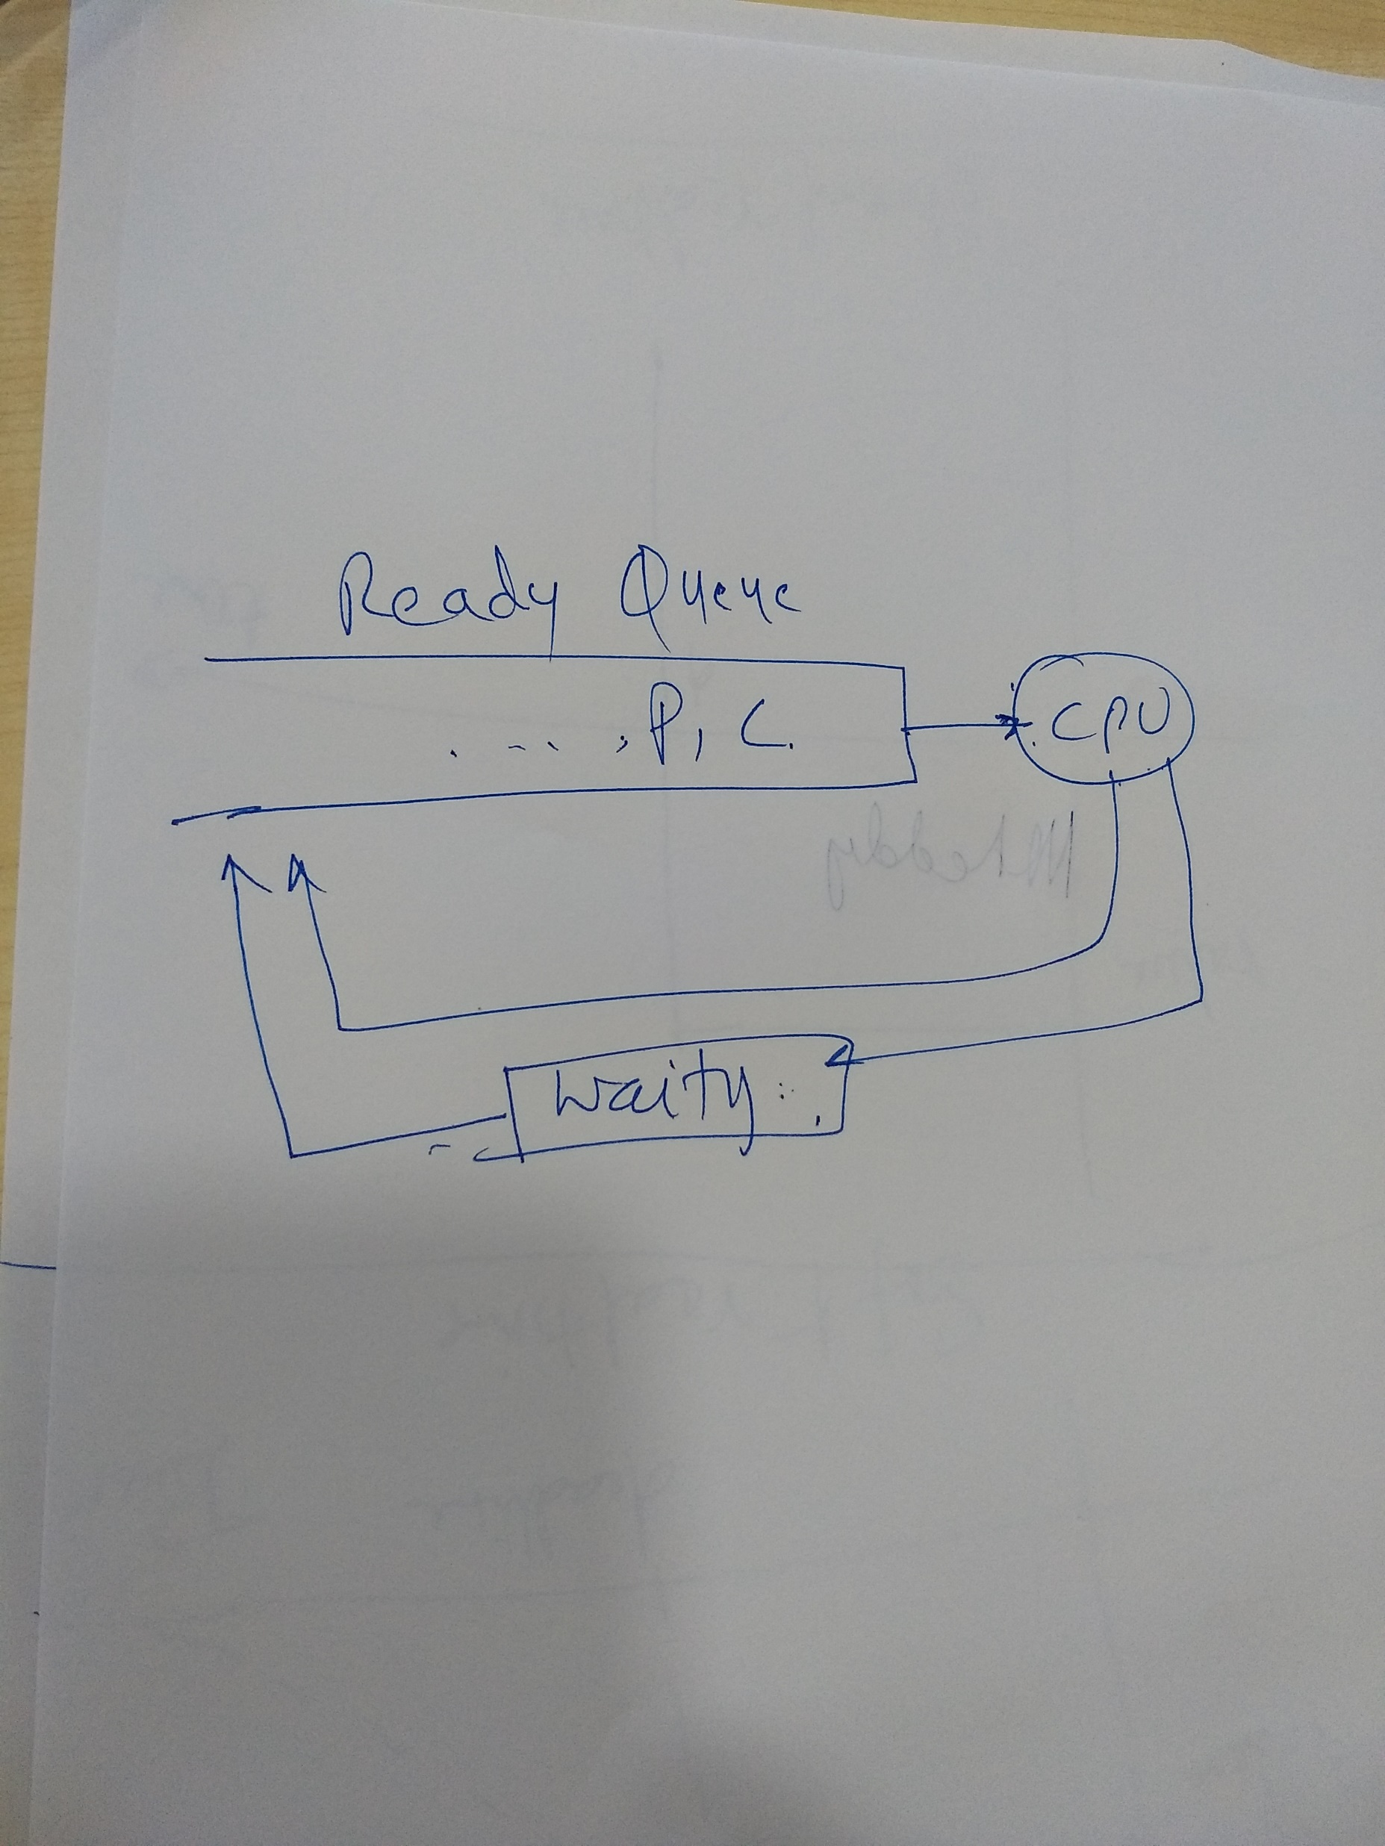

Slide 5
Bounded-Buffer
Shared data
      #define BUFFER_SIZE 10
      typedef struct {
      . . .
      } item;
      item buffer[BUFFER_SIZE];
      int in = 0;
      int out = 0;
      int counter = 0;

Slide 6
Bounded-Buffer
Producer process
item nextProduced;
while (1) {
while (counter == BUFFER_SIZE)
; /* do nothing */
buffer[in] = nextProduced;
in = (in + 1) % BUFFER_SIZE;
counter++;
}

Slide 7
Bounded-Buffer
Consumer process
item nextConsumed;
while (1) {
while (counter == 0)
; /* do nothing */
nextConsumed = buffer[out];
out = (out + 1) % BUFFER_SIZE;
counter--;
}

Slide 8
Bounded Buffer
Although, both the producer and consumer routines are correct separately they may not function correctly when executed concurrently.
The statements
counter++;
counter--;
must be performed atomically.
Atomic operation means an operation that completes in its entirety without interruption.

Slide 9
Bounded Buffer
The statement “count++” may be implemented in machine language as:
register1 = counter
register1 = register1 + 1
counter = register1
The statement “count—” may be implemented as:
register2 = counter
register2 = register2 – 1
counter = register2

Slide 10
Bounded Buffer
If both the producer and consumer attempt to update the buffer concurrently, the assembly language statements may get interleaved.
Interleaving depends upon how the producer and consumer processes are scheduled.

Slide 11
Bounded Buffer
Assume counter is initially 5. One interleaving of statements is:
producer: register1 = counter (register1 = 5)
producer: register1 = register1 + 1 (register1 = 6)
consumer: register2 = counter (register2 = 5)
consumer: register2 = register2 – 1 (register2 = 4)
producer: counter = register1 (counter = 6)
consumer: counter = register2 (counter = 4)
The value of count may be either 4 or 6, where the correct result should be 5.

Slide 12
Race Condition
Race condition: The situation where several processes access – and manipulate shared data concurrently. The final value of the shared data depends upon which process finishes last.
To prevent race conditions, concurrent processes must be synchronized.

Slide 13
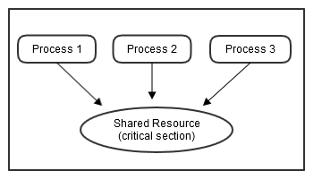

Slide 14
The Critical-Section Problem
n processes all competing to use some shared data
Each process has a code segment, called critical section, in which the shared data is accessed.
Problem – ensure that when one process is executing in its critical section, no other process is allowed to execute in its critical section.

Slide 15
Solution to Critical-Section Problem
A solution to critical section problem must satisfy the following conditions.
  Mutual Exclusion. If process P_{i} is executing in its critical section, then no other processes can be executing in their critical section.
  Progress. At least one process requesting entry into CS will be able to enter it if there is no other process in it..
  Bounded Waiting. No process waits indefinitely to enter CS once it has requested entry.
Assume that each process executes at a nonzero speed
No assumption concerning relative speed of the n processes.

Slide 16
Two approaches
Several kernel-level processes may active at a time
  Example: Data structure “List of open files”
Kernel developers should ensure that OS is free from race conditions.
Two approaches are ued
Non-preemptive kernel
  A non-preemptive kernel does not allow a process running in the kernel mode to be preempted.
  Kernel mode process runs until it exists kernel mode, blocks, or voluntarily yields the control of CPU
  Free from race conditions
Preemptive kernel
  A preemptive kernel allows a process to be pre-empted while it is running in kernel mode.
  Should be carefully designed
  Difficult to design especially in SMP
Why we prefer preemptive kernels ?
  Suitable for realtime programming
  More responsive as kernel mode process can not run for a longer time.
WINDOWS XP, WINDOWS 2000, Prior to LINUX 2.6 are non-preemptive
Solaris and IRIX are preemptive

Slide 17
Mutual exclusion: Software approaches
Software approaches can be implemented
Assume elementary mutual exclusion at the memory access level.
  Simultaneous access to the same location in main memory are serialized in some order.
Beyond this, no other support in the hardware, OS, programming language is assumed.

Slide 18
Two process solution
Initial Attempts to Solve Problem
Dekker’s algorithm
Reported by Dijkstra, 1965.
Only 2 processes, P₀ and P₁
General structure of process P_{i} (other process P_{j})
do {
entry section
critical section
exit section
reminder section
} while (1);
Processes may share some common variables to synchronize their actions.

Slide 19
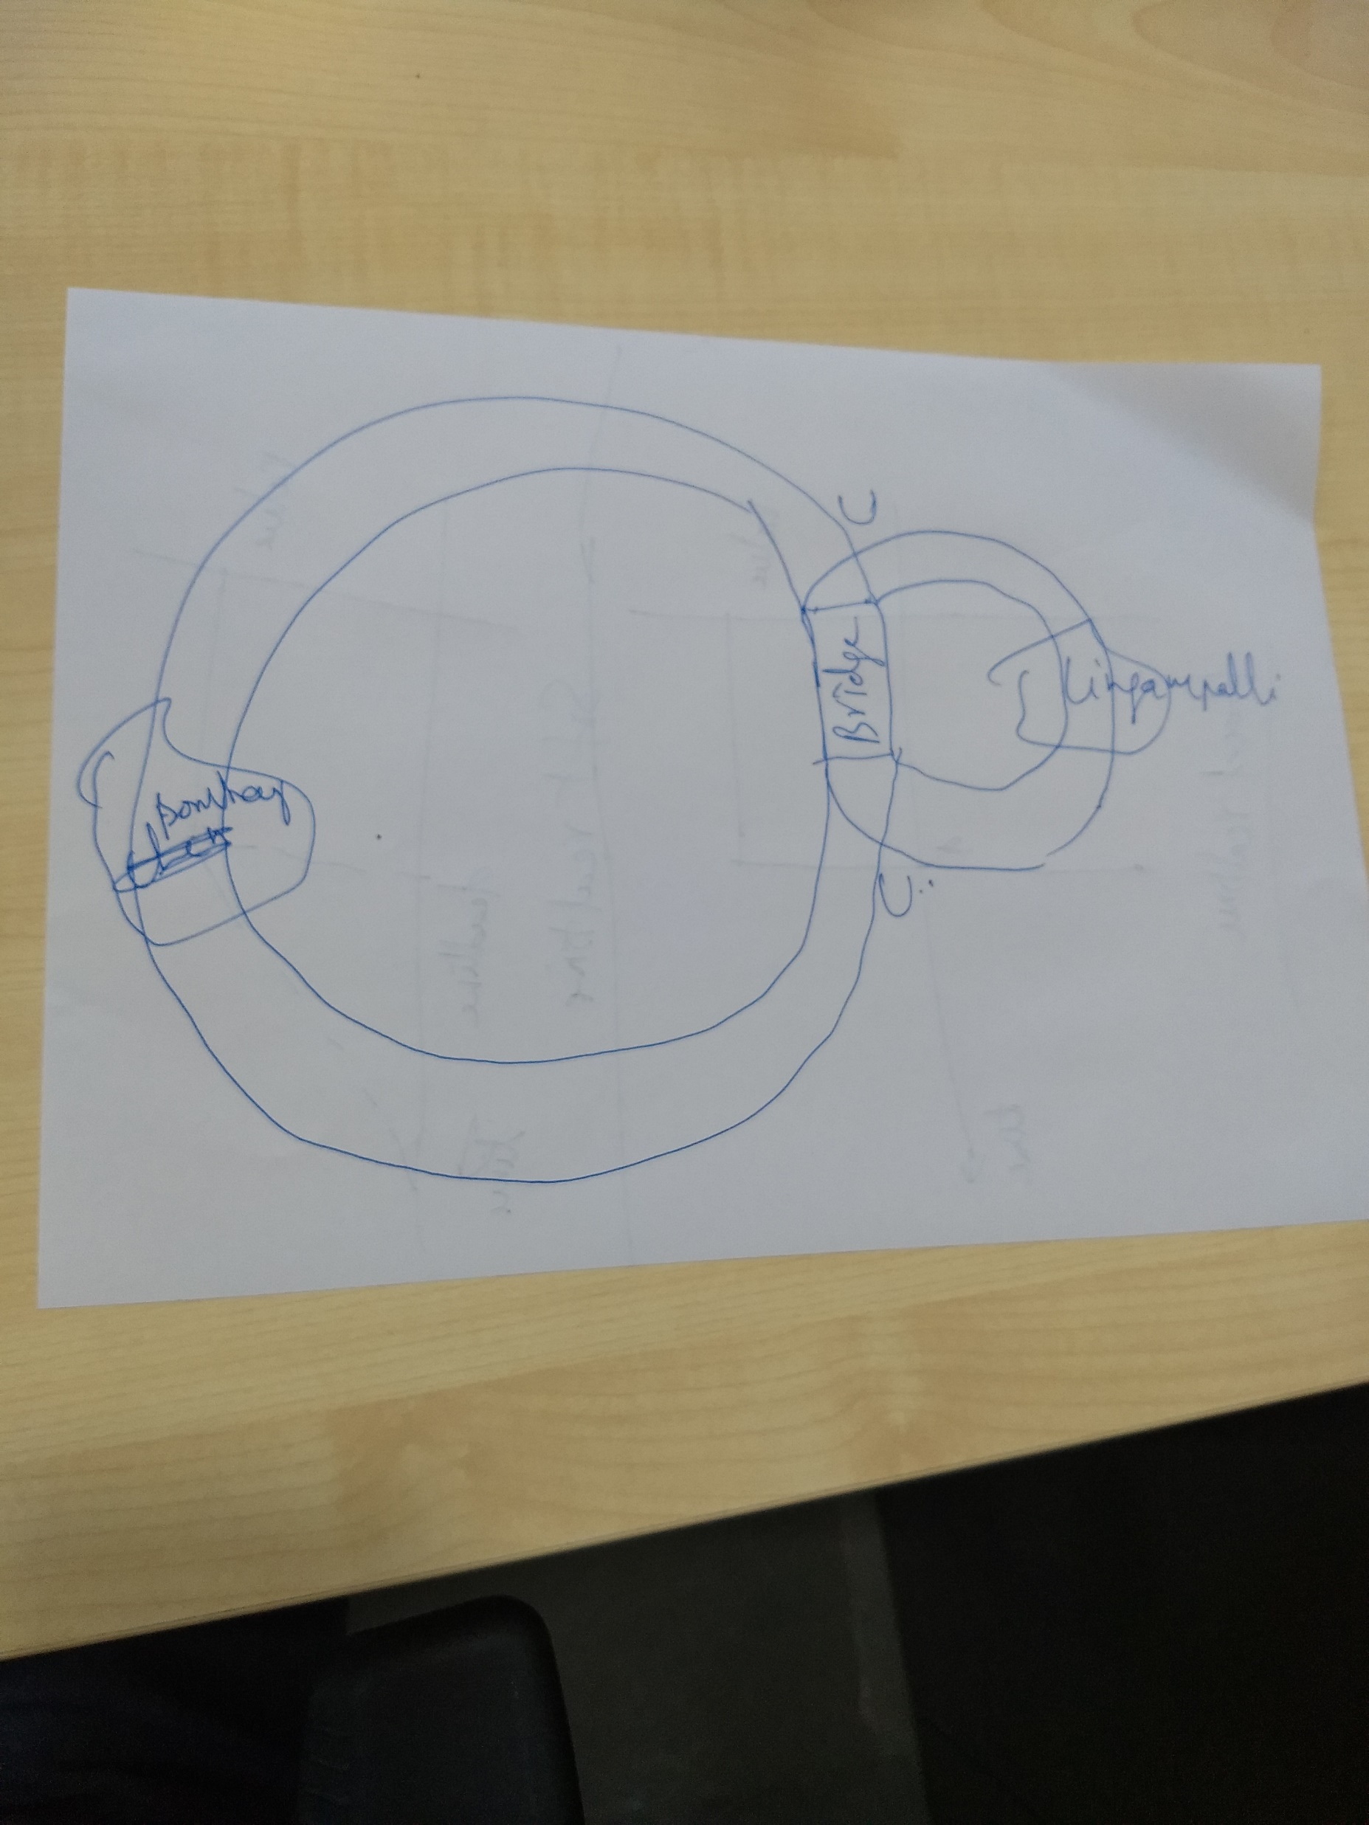

Slide 20
Algorithm 1
Shared variables:
  int turn;
  initially turn = 0
Turn variable
  P0 P1
  while (turn != 0) ; while (turn != 1);
  /* Do nothing */ /* Do nothing */
  critical section critical section
  turn = 1; turn = 0;
  remainder section remainder section
  Shared variable turn indicates who is allowed to enter next, can enter if turn = me
  On exit, point variable to other process
  Deadlock if other process never enters
+Satisfies mutual exclusion: Only one process can enter in CS
-It does not satisfy the progress requirement, as it requires strict alternation of processes to enter CS.
The pace of execution is dictated by slower process.
If turn=0, P1 is ready to enter into CS, P1 can not do so, even though P0 may be in the RS.
If one process fails in CS or RS, other process is blocked permanently.

Slide 21
Algorithm 2
Problem with Alg1
  It does not retain sufficient information about the state of each process.
  Alg1 remembers only which process is allowed to enter the CS.
To solve this problem, variable turn is replaced by boolean flag[2]; flag[0] is for P0; and flag[1] is for P1.
Each process may examine the other’s flag but may not alter it.
When a process wishes to enter CS, it periodically checks other’s flag until that flag is false (other process is not in CS)
The process sets its own flag true and enters CS.
When it leaves CS, it sets its flag to false.

Slide 22
Algorithm 2…
initially flag [0] = flag [1] = false.
P0 P1
  while ( flag[1] ) ; while ( flag[0] )
  /* Do nothing */ /* Do nothing */
  flag[0] = true; flag[1] = true;
  critical section critical section
  flag[0] = false; flag[1] = false;
Mutual exclusion is satisfied.
If one process fails outside CS the other process is not blocked.
Sometimes, the solution is worst than previous solution.
  It does not even guarantee ME.
    P0 executes the while statement and fins flag[1] set to false.
    P1 executes the while statement and fins flag[0] set to false.
    P0 sets flag[0] to true and enters its CS.
    P1 sets flag[1] to true and enters its CS.

Slide 23
Algorithm 3
Interchange the first two statements.
Busy Flag Modified
  P0 P1
  flag[0] = true; flag[1] = true;
  while ( flag[1] ); while ( flag[0] );
  /* Do nothing */ /* Do nothing */
  critical section critical section
  flag[0] = false; flag[1] = false;
Guarantees ME
Both processes set their flags to true before either has executed the while statement, then each will think the other has entered CS causing deadlock.

Slide 24
Correct solution (1)
Combining the key ideas of previous algorithms
Dekker’s Algorithm
  Use flags for mutual exclusion, turn variable to break deadlock
  Handles mutual exclusion, deadlock, and starvation
Dekker’s Algorithm
Initial state: flag[0]=flag[1]=false; turn=1
  P0 P1
  flag[0] = true; flag[1] = true;
  while ( flag[1] ) while ( flag[0])
  if (turn==1) if (turn==0)
  { {
  flag[0]=false; flag[1]=false;
  while (turn==1) while (turn==0)
  /* do nothing */ /* do nothing */
  flag[0]=true; flag[1]=true;
  } }
  /* critical section */ /* critical section */
  turn=1; turn=0;
  flag[0] = false; flag[1] = false;
  remainder section remainder section

Slide 25
Correct solution (2)
Peterson’s Algorithm
Initial state: flag[0]=flag[1]=false;
  P0 P1
  flag[0] = true; flag[1] = true;
  turn = 1; turn = 0;
  while ( flag[1] && turn==1) while ( flag[0] && turn==0)
  /* Do Nothing */; /* Do nothing */;
  critical section critical section
  flag[0] = false; flag[1] = false;
  remainder section remainder section

Slide 26
Correct solution
We need to show that
  ME is preserved
  The progress requirement is satisfied
  The bounded-waiting requirement is met.
ME is preserved
  If both processes enter the CS both flad[0]==flag[1]==true
  Both could not execute while loop successfully as turn is either 0 or 1.
Progress.
  While P1 exits CS it sets flag[1]=false, allowing P0 to enter CS.
  P1 and P0 will enter the CS (Progress)
Bounded waiting: P1 will enter the CS after at most one entry by P0 and vice versa.

Slide 27
Multi-process solution: Bakery Algorithm
Critical section for n processes
Based on scheduling algorithm commonly used in bakeries.
  On entering the store the customer receives the number.
  The customer with the lowest number is served.
  Customers may receive the same number, then the process with the lowest name is served first.
Before entering its critical section, process receives a number. Holder of the smallest number enters the critical section.
If processes P_{i} and P_{j} receive the same number, if i < j, then P_{i} is served first; else P_{j} is served first.
The numbering scheme always generates numbers in increasing order of enumeration; i.e., 1,2,3,3,3,3,4,5...

Slide 28
Bakery Algorithm
var: choosing: array[0…n-1] of boolean.
Notation <≡ lexicographical order (ticket #, process id #)
  (a,b) < c,d) if a < c or if a = c and b < d
  max (a₀,…, a_{n-1}) is a number, k, such that k ≥ a_{i} for i =0,
  …, n – 1
Shared data
boolean choosing[n];
int number[n];
Data structures are initialized to false and 0 respectively

Slide 29
Bakery Algorithm
do {
choosing[i] = true;
number[i] = max(number[0], number[1], …, number [n – 1])+1;
choosing[i] = false;
for (j = 0; j < n; j++) {
while (choosing[j]) ;
while ((number[j] != 0) && (number[j,j] < number[i,i])) ;
}
critical section
number[i] = 0;
remainder section
} while (1);
Consider Pi in its CS and Pk is trying to enter CS
When Pk enters second while statement for j=i, it finds that
  number[i] ≠ 0
  (number[i],i) < (number[k].k)
  So it waits until Pi leaves CS
FCFS is followed.

Slide 30
Mutual exclusion: hardware solution
In the uni-processor system, it is sufficient to prevent a process from being interrupted.
  while (true){
  /* disable interrupts */
  /* Critical section */
  /* enable interrupts */
  /* remainder */
  }
Since CS can not be interrupted ME is guaranteed.
The efficiency decreases
It can not work in multi-processor environments
  More than one process is executing at a time.

Slide 31
Special machine instructions
In multi-processor configuration, several processes share access to a common main memory.
At the hardware level, access to a memory location excludes any other access to that same memory location.
Processor designers have proposed several machine instructions to carry out two actions atomically (single cycle).
  Reading and writing
  swapping

Slide 32
Test and set instruction
Test and modify the content of a word atomically
  boolean testset (int i)
  {
  if (i==0)
  {
  i=1;
  return true;
  }
  else
  {
  return false
  }
  }
This instruction sets the value of ‘i’, if the value=0 and returns true. Otherwise the value is not changed and false is returned.

Slide 33
Mutual Exclusion with Test-and-Set
Shared data:
boolean lock = false;
void P(int i)
do {
while (TestAndSet(lock)==false)
/* do nothing*/;
critical section
lock = false;
remainder section
}
void main()
{
lock=false;
parbegin(P1(), P(2),….,P(n));
}

Slide 34
Test-and-Set: Correctness
Mutual exclusion
  A shared variable lock is set to false
  The only process Pi that enters CS that finds lock as false and sets it to true.
  All other processes trying to enter CS so into a busy waiting mode and finds lock as false.
  When process leaves C it resents lock to false.
  When Pi exits lock is set to false so the next process Pj to execute instruction find test-and-set=false and will enter the CS.
Progress
  Trivially true
Unbounded waiting
  Possible since depending on the timing of evaluating the test-and-set primitive.
  Does not guarantee fairness.

Slide 35
Swap instruction
Atomically swap two variables.
void swap(boolean &a, boolean &b) {
boolean temp = a;
a = b;
b = temp;
}

Slide 36
Mutual Exclusion with Swap
Shared data (initialized to false):
boolean lock;
  boolean waiting[n];
Process P_{i}
do {
key = true;
while (key == true)
Swap(lock,key);
critical section
lock = false;
remainder section
}

Slide 37
SWAP: Correctness
Similar to Test-and-set
Mutual exclusion
Progress
  Trivially true
Unbounded waiting
  Possible since depending on the timing of evaluating the test-and-set primitive.
  Does not guarantee fairness.

Slide 38
Can we get bounded waiting ?
Introduce a boolean array called waiting of size n and boolean variable key
Entry
  waiting[i]:=true;
  key:=true;
  while (waiting[i] and key ) do
    key := test-and-set(lock);
  waiting[i]:=false;
  execute CRITICAL SECTION
Exit
  Find the next process j that has waiting[j]=1 stepping through waiting.
  Set waiting[j]:=false;
  Process P_{j} immediately enter the CS.
  If no process exists, set lock=false;

Slide 39
Can we get bounded waiting ?....
Every (interested) Pi executes that test&set at least once.
Pi enters the critical section provided:
  Key is false in which case there is no process in CS.
Or
  If it was waiting, because waiting[i] was reset to false by the unique process that was blocking it in the critical section.
  Either of the above events occur exactly once and hence mutual exclusion.

Slide 40
Properties of machine instruction approach
+ve
  Any number of processes
  Simple and easy
  Can support multiple CSs.
-ve
  Busy waiting is employed
    The process is waiting and consuming processor time.
  Starvation is possible.
    The selection of waiting process is arbitrary.
  Deadlock is possible due to priority
    P1 enters CS and interrupted by higher priority process P2 which is trying to enter CS.
    P2 can not get CS unless P1 is out and P1 can not be dispatched due to low priority.

Slide 42
Mutex Locks
Test-set locks are also called mutex llocks
Mutex means mutual exclusion.

Slide 43
Semaphores: Dijkstra; 1965
Two and more processes can cooperate by means of simple signals, such that a process is forced to stop at a specified place until it has received a specific signal.
For signaling, special variables called semaphores are used
A semaphore is a synchronization tool.
A semaphore is an integer variable that is accessed only through two standard atomic operations: wait and signal.
To transmit a signal to semaphore S, a process executes the primitive signal(S) primitive.
To receive a signal via semaphore S, the process executes wait(S) primitive.

Slide 44
Semaphores: Dijkstra 1965
Classical or first definition
A semaphore is initialized to a non-negative value
The wait operation decrements the semaphore value. If the integer value is negative the process waits.
The signal operation increments the semaphore value. If the value is not positive, then process which is blocked by a wait operation is gets the access to CS.
The wait and signal are assumed to be atomic.
Semaphore S – integer variable
can only be accessed via two indivisible (atomic) operations
wait (S):
while S≤ 0 do no-op;
S--;
signal (S):
S++;

Slide 45
Critical Section of n Processes
Shared data:
semaphore mutex; // initially mutex = 1
Process Pi:
do {
wait(mutex);
critical section
signal(mutex);
remainder section
} while (1);
Modifications to the integer value of the semaphore in the wait and signal operations must be executed indivisibly.

Slide 46
Semaphore Implementation
The classical definition requires busy waiting.
While a process is in CS, the other process must loop continuously in the entry code.
Busy waiting wastes CPU cycles.
This type of semaphore is called spinlock: process spins while waiting for a lock.
  Advantage of spinlock: no context switch
  When locks are expected to be held for short times, spinlocks are useful.
To overcome the need for busy waiting, we can modify the definition of the wait and signal semaphore operations.
If a process executes wait operation and finds the semaphore operation is not positive, it must wait.
  Rather than busy waiting it must block itself.
  The block operation puts the process into waiting queue of semaphore and process is switched to waiting state.
A process that is blocked waiting on a semaphore S, should be restarted when some other process executes signal operation.
The process is restarted with wakeup operation.

Slide 47
Semaphore Implementation
Define a semaphore as a record
typedef struct {
int value;
struct process *L;
} semaphore;
Assume two simple operations:
  block suspends the process that invokes it.
  wakeup(P) resumes the execution of a blocked process P.

Slide 48
Implementation
Semaphore operations now defined as
wait(S):
S.value--;
if (S.value < 0) {
add this process to S.L;
block;
}
signal(S):
S.value++;
if (S.value <= 0) {
remove a process P from S.L;
wakeup(P);
}
Wait and signal operations are system calls.

Slide 49
Semaphore as a General Synchronization Tool
Execute B in P_{j} only after A executed in P_{i}
Use semaphore flag initialized to 0
Code:
P_{i} P_{j}
 
A wait(flag)
signal(flag) B

Slide 50
Deadlock and Starvation
Deadlock – two or more processes are waiting indefinitely for an event that can be caused by only one of the waiting processes.
Let S and Q be two semaphores initialized to 1
P₀ P₁
wait(S); wait(Q);
wait(Q); wait(S);
 
signal(S); signal(Q);
signal(Q) signal(S);
Starvation – indefinite blocking. A process may never be removed from the semaphore queue in which it is suspended.

Slide 51
Two Types of Semaphores
Counting semaphore – integer value can range over an unrestricted domain.
Binary semaphore – integer value can range only between 0 and 1; can be simpler to implement.

Slide 52
Binary Semaphores
A binary semaphore is a semaphore with an integer value that can range only between 0 and 1
It is simple to implement.
Type binary semaphore =record
      value:(0,1)
      queue: list of processes
      end;
var s: binary semaphore
waitB(s):
  If s.value=1 then
    s.value=0
  else
  begin
  place this process in s.queue;
  block this process;
  end;
signalB(s):
  If s.queue is empty then
  s.value=1
  else
  begin
  remove (wakeup) the process from s.queue;
  place this process in the ready list.
  end;

Slide 53
Implementing S as a Binary Semaphore
Can implement a counting semaphore S as a binary semaphore.
Data structures:
binary-semaphore S1, S2;
int C:
Initialization:
S1 = 1
S2 = 0
C = initial value of semaphore S
  wait operation
wait(S1);
C--;
if (C < 0) {
signal(S1);
wait(S2);
}
signal(S1);
  signal operation
  wait(S1);
  C ++;
  if (C <= 0)
  signal(S2);
  else
  signal(S1);
Counting semaphores
wait(S):
S.value--;
if (S.value < 0) {
add this process to S.L;
block;
}
signal(S):
S.value++;
if (S.value <= 0) {
remove a process P from S.L;
wakeup(P);
}

Slide 54
Classical Problems of Synchronization
Bounded-Buffer Problem
Readers and Writers Problem
Dining-Philosophers Problem

Slide 55
Bounded-Buffer Problem
Used to to illustrate the power of synchronization techniques
We assume that the buffer consists of n buffers, each capable of holding an item.
The mutex semaphore provides mutual exclusion access to buffer which is initialized to the value 1.
The empty and full semaphores count the number of empty and full buffers which are initialized to n and zero respectively.
Shared data
semaphore full, empty, mutex;
Initially:
full = 0, empty = n, mutex = 1

Slide 56
Bounded-Buffer Problem Producer Process
do {
…
produce an item in nextp
…
wait(empty);
wait(mutex);
…
add nextp to buffer
…
signal(mutex);
signal(full);
} while (1);

Slide 57
Bounded-Buffer Problem Consumer Process
do {
wait(full)
wait(mutex);
…
remove an item from buffer to nextc
…
signal(mutex);
signal(empty);
…
consume the item in nextc
…
} while (1);
Producer is producing full buffers for the consumer and consumer is producing empty buffers for the consumer.

Slide 58
Readers-Writers Problem
Problem: A data object (file or record) is shared among several concurrent processes.
  Some want to read and others want to update it.
Readers: processes interested in reading.
Writers: processes interested in writing.
Two readers can access shared data object simultaneously.
But a writer and reader can access shared data object simultaneously
  problems may occur!
To protect from these problems, writers should have an exclusive access to the shared object.
This synchronization problem is referred to as readers-writers problem.
It is a different kind of synchronization problem.
The readers-writers problem has several variations.
  Simple one: No reader will be kept waiting unless writer has obtained permission to write.

Slide 59
Readers-Writers Problem
Semaphores used: mutex and wrt
The semaphore wrt is common to reader and writer.
Semaphore mutex is used to update readcount.
readcount keeps track of how many are reading the object.
Shared data
semaphore mutex, wrt;
Initially
mutex = 1, wrt = 1, readcount = 0

Slide 60
Readers-Writers Problem Writer Process
wait(wrt);
…
writing is performed
…
signal(wrt);

Slide 61
Readers-Writers Problem Reader Process
wait(mutex);
readcount++;
if (readcount == 1)
wait(wrt);
signal(mutex);
…
reading is performed
…
wait(mutex);
readcount--;
if (readcount == 0)
signal(wrt);
signal(mutex):
Writers can be starved if there is a continuous sequence of readers.

Slide 62
Readers-Writers Problem
Can the producer/consumer problem is considered as case of the readers/writers problem with a writer is a producer and reader is a consumer ?
The answer is no
The producer is not just a writer
  It must read queue of pointers to determine where to write the next item and it must determine if the buffer is full.
Similarly the consumer is not a reader
  It must adjust queue pointers to show that it has removed a unit from the buffer.

Slide 63

Dining-Philosophers Problem
Five philosophers spend their lives on thinking and eating.
They share a common circular table surrounded by five chairs.
Five single chopsticks are available.
Whenever a philosopher wants to eat, he tries to pick up two chopsticks that are closest to him/her.
A philosopher can not pick the chopstick in the hand of neighbor.
After finishing, the philosopher puts back the chopsticks and starts thinking.
It is simple representation of the need to allocate several resources among several processes in a deadlock and starvation free manner.

Slide 64
Dining-Philosophers Problem
Shared data
semaphore chopstick[5];
Initially all values are 1
Philosopher i:
do {
wait(chopstick[i])
wait(chopstick[(i+1) % 5])
…
eat
…
signal(chopstick[i]);
signal(chopstick[(i+1) % 5]);
…
think
…
} while (1);
The solution creates a deadlock

Slide 65
Barbershop Problem
3 barbers, each with a barber chair
  Haircuts may take varying amounts of time
Sofa can hold 4 customers, max of 20 in shop
Customers wait outside if necessary
When a chair is empty:
  Customer sitting longest on sofa is served
  Customer standing the longest sits down
After haircut, go to cashier for payment
  Only one cash register
  Algorithm has a separate cashier, but often barbers also take payment
    This is also a critical section

Slide 66
Barbershop Problem
The main body of the program activates 50 customers, 3 barbers, and the cashier process. Synchronization operators.
  Shop and sofa capacity: the capacity of shop and the capacity of the sofa are governed by the semaphores max_capacity and sofa.
    When customer enters max_capacity decremented by one.
    When a customer leaves it is incremented.
    Wait and signal operations are surround the actions of sitting and getting_up from sofa.
  Barber chair capacity:
    There are three barber chairs; the semaphore barber_chair assures that no more than three customers attempt to obtain service at a time.
    A customer will not get up from the sofa until at least one chair is free.
  Ensuring customers are in the barber chair: The semaphore cust_ready provides a wakeup signal for a sleeping barber indicating that the customer has just taken the chair.
  Holding customers in barber chair: once seated the customer remain in the chair until the barber gives the signal that haircut is complete, using the semaphore finished.
  Limiting one customer to a barber chair: the semaphore barber_chair is intended to limit the number of customers in barber chairs to three. The semaphore leave_b_chair is used to synchronize sitting.
  Paying and receiving: payment and receipt semaphores are used to synchronize the operations.
  Coordinating barber and cashier functions: To save money the barber shop does not employ a separate cashier. Each barber is required to perform that task when not cutting hair. The semaphore coord ensures the barbers perform only one task at a time.

Slide 67
Barbershop Problem
Semaphore | Wait operation | Signal operation
max_capacity | Customer waits for a room to enter shop. | Exiting customer signals customer waiting to enter
sofa | Customer waits for seat on sofa | Customer leaving sofa signals customer waiting for sofa
barber_chair | Customer waits for empty barber chair | Barber signals when that barber’s chair is empty
Cust_read | Barber waits until customer is in the chair | Customer signals barber that customer is in the chair
finished | Customer waits until his haircut is complete. | Barber signals when done cutting hair of his customer.
leave_b_chair | Barber waits until customer gets up from the chair | Customer signals barber when customer gets up from chair.
payment | Cashier waits for a customer to pay | Customer signals cashier that he has paid.
receipt | Customer waits for a receipt for a payment | Cashier signals that payment has been accepted.
coord | Wait for a barber resource to be free to be free perform either the hair cutting or cashiering function. | Signal that a barber resource is free.

Slide 68
Barbershop
program barbershop1;
var max_capacity: semaphore (:=20);
sofa: semaphore (:=4);
barber_chair, coord: semaphore (:=3);
cust_ready, leave_b_chair, payment, receipt: semaphore (:=0)
procedure customer; procedure barber; procedure cashier;
var custnr: integer; var b_cust: integer begin
begin begin repeat
wait (max_capacity ); repeat wait( payment );
enter shop; wait( cust_ready ); wait( coord );
accept payment;
signal( coord );
signal( receipt );
wait( coord ); forever
wait( sofa ); cut hair; end;
sit on sofa; signal( coord );
wait( barber_chair ); signal( finsihed[b_cust] );
get up from sofa; wait( leave_b_chair );
signal( sofa ); signal( barber_chair );
sit in barber chair; forever
wait( mutex2 ); end;
signal( cust_ready );
wait( finished[custnr] );
leave barber chair;
signal( leave_b_chair );
pay;
signal( payment );
wait( receipt );
exit shop;
signal( max_capacity );
end;
Void main()
{
count=0;
Parbegin {customer… 50 times,…customer,
Barber, barber,barber, cashier)
}

Slide 69
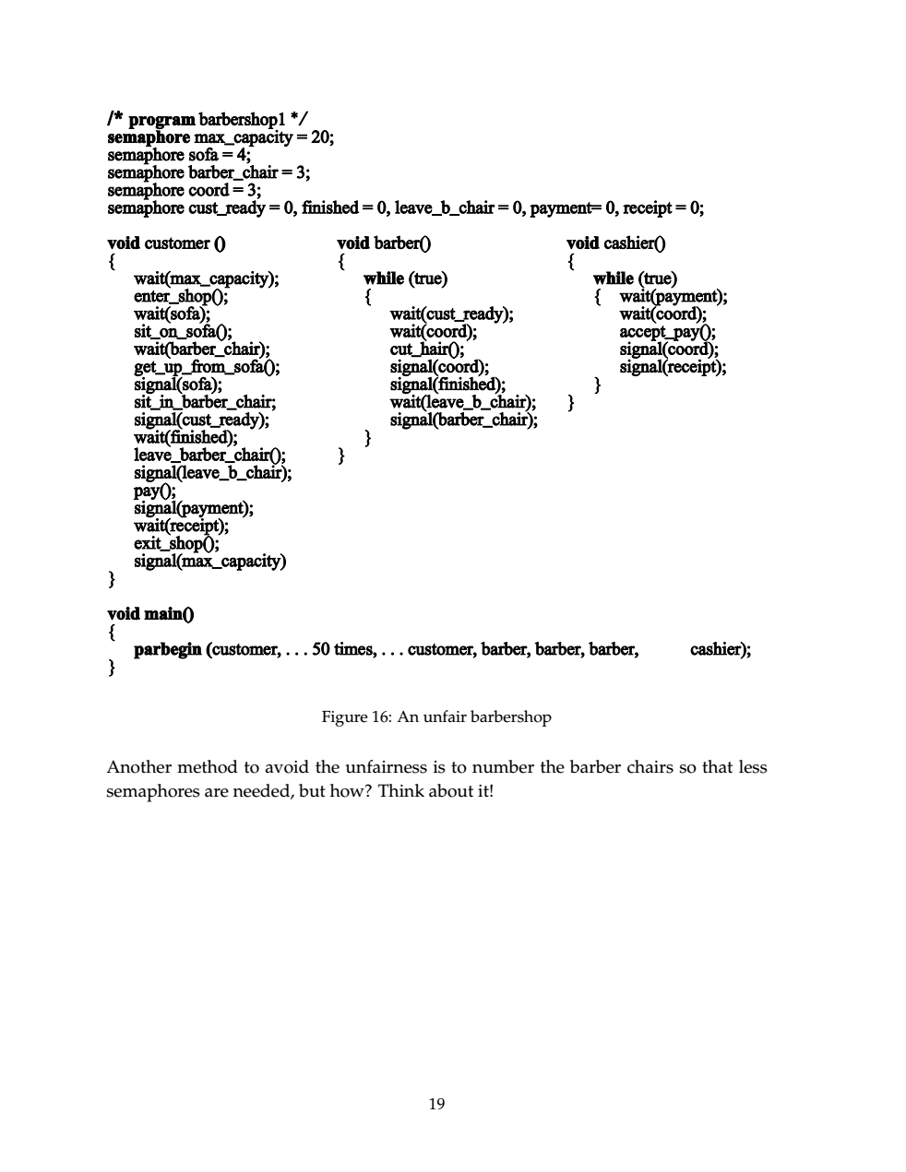

Slide 70
Barbershop Problem
The preceding solution is unfair.
The customers are servers in the order they enter the shop.
If one barber is very fast and one of the customer is quite bald.
The problem can be solved with more semaphores.
  We assign unique customer number is to each customer.
  The semaphore mutex1 protects access to global variable count.
The semaphore finished is refined to be an array of 50 semaphores.
  Once a customer seated in a barber chair, he executes wait(finished[custnt]) to wait in his own unique semaphore.
Please see the solution in Willium Stallling book (pp 229-234)

Slide 71
Fair Barbershop
program barbershop2;
var max_capacity: semaphore (:=20);
sofa: semaphore (:=4);
barber_chair, coord: semaphore (:=3);
mutex1, mutex2: semaphore (:=1);
cust_ready, leave_b_chair, payment, receipt: semaphore (:=0)
finished: array [1..50] of semaphore (:=0);
count: integer;
procedure customer; procedure barber; procedure cashier;
var custnr: integer; var b_cust: integer begin
begin begin repeat
wait (max_capacity ); repeat wait( payment );
enter shop; wait( cust_ready ); wait( coord );
wait( mutex1 ); wait( mutex2 ); accept payment;
count := count + 1; dequeue1( b_cust ); signal( coord );
custnr := count; signal( mutex2 ); signal( receipt );
signal( mutex1 ); wait( coord ); forever
wait( sofa ); cut hair; end;
sit on sofa; signal( coord );
wait( barber_chair ); signal( finsihed[b_cust] );
get up from sofa; wait( leave_b_chair );
signal( sofa ); signal( barber_chair );
sit in barber chair; forever
wait( mutex2 ); end;
enqueue1( custnr );
signal( cust_ready );
signal( mutex2 );
wait( finished[custnr] );
leave barber chair;
signal( leave_b_chair );
pay;
signal( payment );
wait( receipt );
exit shop;
signal( max_capacity );
end;
Void main()
{
count=0;
Parbegin {customer… 50 times,…customer,
Barber, barber,barber, cashier)
}

Slide 72
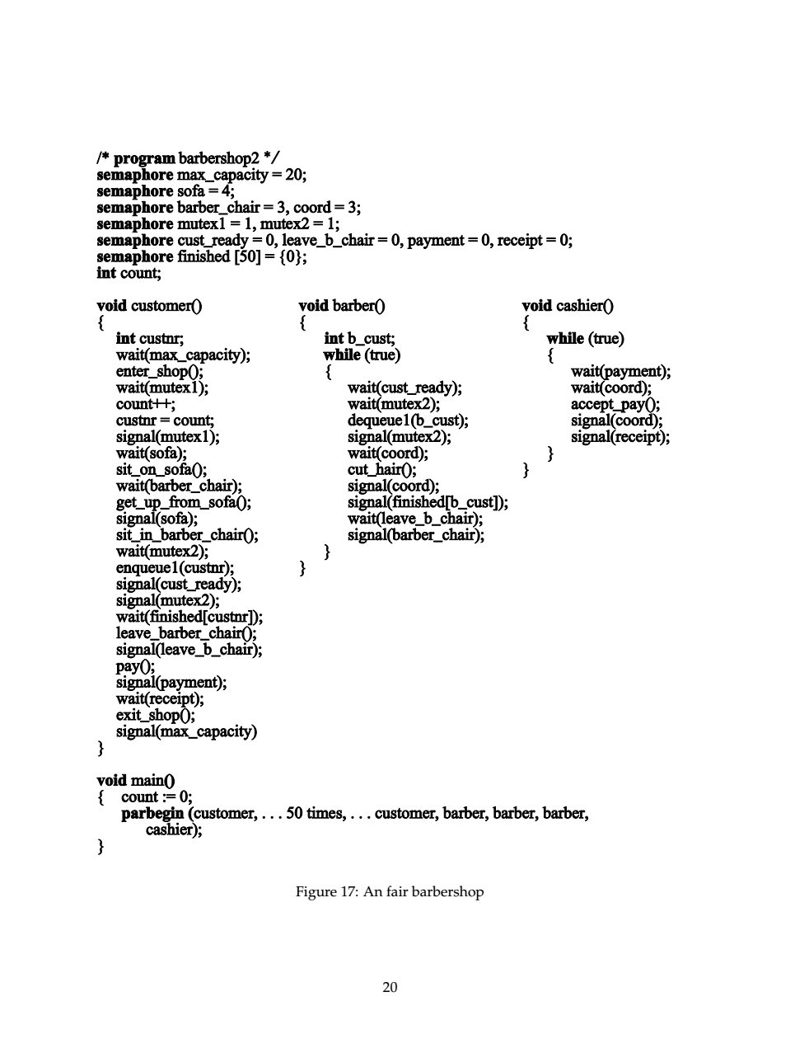

Slide 73
Implementing wait() and signal() in Multi-processor Systems
Disabling interrupts will not work.
Spinlock is the solution
  With this we have moved busy waiting from entry section to critical sections of application programs.

Slide 74
Implementation of Semaphores
wait and signal operations are atomic.
No two processes should execute wait and signal on the same semaphore at the same time
Good Solution: implement through hardware or firmware.
Other solutions
  Ensure that only process manipulates “wait” and “signal” operations.
  One can use Dekker’s algorithm or Peterson’s algorithm
    Substantial processing overhead
  Use one of the hardware supported schemes
    Test and set
    disabling interrupts (single processor)

Slide 75
About busy waiting
Note: we have not eliminated the busy waiting with wait() and signal() completely.
  Moved busy waiting from entry section to critical sections of application programs.
  Furthermore, we have limited busy waiting to critical sections of wait() and signal() operations.
  The wait and signal code is very short the amount of busy waiting involved is short.

Slide 76
Two possible implementations of Semaphores
Wait(s)
{
while(!testset(s.flag)
/* do nothing */
s.count--;
if (s.count <0)
{
place this process in s.queue;
block this process (set s.flag to 0)
}
else
s.flag=0;
}
Wait(s)
{
Inhibit interrupts
s.count--;
if (s.count <0)
{
place this process in s.queue;
block this process allow interrupts
}
else
allow interrupts;
}
Signal(s)
{
Inhibit interrupts;
s.count++;
if (s.count <= 0)
{
remove a process P from s.queue;
Place a process P in the ready list
}
allow interrupts;
}
Signal(s)
{
while(!testset(s.flag)
/* do nothing */
s.count++;
if (s.count <= 0)
{
remove a process P from s.queue;
Place a process P in the ready list
}
s.flag=0;
}
With Interrupts
With TestSet Instruction

Slide 77
Problem with semaphores
Incorrect use may result in timing errors
These errors are difficult to detect as these occur if only particular sequence occurs.
Missing or reverse order.
It is difficult to produce correct program using semaphores.
The wait and signal operations are scattered throughout the program and it is difficult to see overall effect of these operations on the semaphores.

Slide 78
Problem with semaphores (cont.)
Problems
  Suppose a process interchanges the order in which wait and signal operations on the semaphore are executed
  signal (mutex)
  CS
  wait (mutex)
    Several processes may be executing in their CS simultaneously.
  Suppose that a process replaces signal(mutex) with wait(mutex)
  signal (mutex) wait(mutex)
  CS CS
  signal (mutex) wait(mutex)
    Deadlock will occur.
  Suppose a process omits wait(mutex) or signal(mutex) or both.
    ME is violated or deadlock occurs.
A critical region and monitor concept is introduced to address this problem

Slide 79
High level synchronization constructs
To deal with the type of errors caused by semaphores, high-level constructs have been introduced.
  Critical region
  Monitor
Assumption
  Process contains some local data
  Local data can be accessed by only the sequential program that is encapsulated within the same process.
  Process can not access the local data of another process.

Slide 80
Monitors
It is an high level synchronization construct.
A monitor is a software module consisting of one or more procedures, an initialization sequence and local data.
Main characteristics
  The local data variables are accessible only by the monitor’s procedures and not by any external procedure.
  A process enters monitor by entering one of its procedures.
  Only one process may be executing (active) in the monitor at any time; any other process that has invoked the monitor is suspended while waiting for the monitor to become available.
1&2 → object oriented characteristics.
By enforcing one procedure at a time, the monitor enforces ME facility.

Slide 81
Monitors
High-level synchronization construct that allows the safe sharing of an abstract data type among concurrent processes.
A shared data resource can be protected by placing in the monitor.
monitor monitor-name
{
shared variable declarations
procedure body P1 (…) {
. . .
}
procedure body P2 (…) {
. . .
}
procedure body Pn (…) {
. . .
}
{
initialization code
}
}

Slide 82
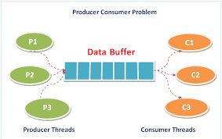
Two kinds of waiting:
Mutual exclusion waiting: to avoid race condition
Conditional waiting: to avoid inconsistency

Slide 83
Monitors
To allow a process to wait within the monitor, a condition variable must be declared, as
condition x, y;
Condition variable can only be used with the operations wait and signal.
  The operation
  x.wait();
  means that the process invoking this operation is suspended until another process invokes
  x.signal();
  The x.signal operation resumes exactly one suspended process. If no process is suspended, then the signal operation has no effect.

Slide 84

Schematic View of a Monitor

Slide 85

Monitor With Condition Variables

Slide 86
Monitors
In case of monitors, the monitor construct itself provides ME, but synchronization is provided by the programmer.
In case of semaphore, both ME and synchronization are provided by the programmer.
Also , in case of monitors also, it is possible to make mistakes in the synchronization of monitors.
For example if csignal function is omitted, the processes entering corresponding queue are permanently hung up.
However, since all synchronization functions are confined to monitor, it is easier to verify the synchronization and detect bugs.
Once a monitor is correctly programmed, access to the protected resource is correct from all processes.
With semaphores, resources access is correct only if all of the processes that access the resource are programmed correctly.

Slide 87
Dining Philosophers Example
Deadlock free solution
A philosopher is allowed to pick up his chopsticks only if both of them were available.
We introduce three states:
  Enum {thinking, hungry, eating} state[5]
Philosopher i can set the variable state[i]=eating only if her two neighbors are not eating: (state[(i+4)%5]!=eating) and (state(i+1)%5)!=eating)
We also declare condition self[5];
  Philosopher i can delay himself when he is hungry, but unable to obtain the chopsticks he needs.

Slide 88
Dining Philosophers Example
Deadlock free solution
monitor dp
{
enum {thinking, hungry, eating} state[5];
condition self[5];
void pickup(int i) // following slides
void putdown(int i) // following slides
void test(int i) // following slides
void init() {
for (int i = 0; i < 5; i++)
state[i] = thinking;
}
}

Slide 89
Dining Philosophers
void pickup(int i) {
state[i] = hungry;
test[i]; // if left and right of i are not eating, then eat.
if (state[i] != eating)
self[i].wait();
}
void putdown(int i) {
state[i] = thinking;
// test left and right neighbors
test((i+4) % 5);
test((i+1) % 5);
}

Slide 90
Dining Philosophers
void test(int i) {
if ( (state[(I + 4) % 5] != eating) &&
(state[i] == hungry) &&
(state[(i + 1) % 5] != eating)) {
state[i] = eating;
self[i].signal();
}
}

Slide 91
Dining Philosophers
dp.pickup[i];
….
eat
….
dp.putdown(i);
It is easy to show that no two neighbors are eating simultaneously and no deadlocks will occur.
However, it is possible for a philosopher to starve to death.

Slide 92
Monitor Implementation Using Semaphores
Variables
semaphore mutex; // (initially = 1)
semaphore next; // (initially = 0)
int next-count = 0;
// number of processes suspended on next.
Each external procedure F will be replaced by
wait(mutex);
…
body of F;
…
if (next-count > 0)
signal(next)
else
signal(mutex);
Mutual exclusion within a monitor is ensured.

Slide 93
Monitor Implementation
For each condition variable x, we have:
semaphore x-sem; // (initially = 0)
int x-count = 0;
The operation x.wait can be implemented as:
x-count++;
if (next-count > 0)
signal(next);
else
signal(mutex);
wait(x-sem);
x-count--;

Slide 94
Monitor Implementation
The operation x.signal can be implemented as:
if (x-count > 0) {
next-count++;
signal(x-sem);
wait(next);
next-count--;
}

Slide 95
Monitor Implementation
Conditional-wait construct: x.wait(c);
  c – integer expression evaluated when the wait operation is executed.
  value of c (a priority number) stored with the name of the process that is suspended.
  when x.signal is executed, process with smallest associated priority number is resumed next.
Check two conditions to establish correctness of system:
  User processes must always make their calls on the monitor in a correct sequence.
  Must ensure that an uncooperative process does not ignore the mutual-exclusion gateway provided by the monitor, and try to access the shared resource directly, without using the access protocols.

Slide 96
Solaris 2 Synchronization
Solaris2 OS is designed to provide real-time computing, be multithreaded and support multiple processors.
To control access to critical regions Solaris 2 implements
  Adaptive mutexes
  Condition variables
  Semaphores
  Reader-writer locks
  Turnstiles
Adaptive mutex protects access to every critical data item.
  On multiprocessor system an adaptive mutex starts as a standard semaphore implemented as a spinlock.
  Adaptive mutex is used to protect only data that are accessed by short-code segments (few hundred instructions).
For longer code segments, condition variables and semaphores are used.
Reader-writers locks are used to access data that is accessed frequently in read-only manner.
  Semaphores serialize the access
  When there are many readers and few writers r-w locks are efficient.
Solaris 2 uses turnstiles to order list of threads waiting to acquire either an adaptive mutex or a reader-writer lock.

Slide 97
Solaris 2 Synchronization
Uses turnstiles to order the list of threads waiting to acquire either an adaptive mutex or reader-writer lock.
  It is a queue structure containing threads blocked in a lock.
To prevent a priority inversion, turnstiles are organized into priority inheritance protocol.
  When a lower priority thread holds a lock, and higher priority thread blocks, the lower priority thread inherits the priority of the higher-priority thread.

Slide 98
Windows 2000 Synchronization
Multi-threaded kernel
  Real-time applications and multiple processors
Uses interrupt masks to protect access to global resources on uni-processor systems.
Uses spinlocks on multiprocessor systems.
  Kernel ensures that a thread will never be preempted while holding a spinlock.
Also provides dispatcher objects which may act as mutexes and semaphores and events.
Dispatcher objects may also provide events. An event acts much like a condition variable which may notify a waiting thread when a desired condition occurs.

Slide 99
Transactional Memory
Multi-core applications increases risk of race conditions and deadlocks.
Techniques proposed: locks, semaphores and monitors
Transactional memory provides alternative strategy
A memory transaction is a sequence of memory read and write transactions that are atomic. If all the operations are completed the memory transaction is committed. Otherwise, the operations must be aborted. Such a feature can be added to programming language.
Traditional way
  Update () {
    Acquire();
    /* Modify shared data */
    release(); }
Suppose we add an atomic operation
  Update() {
  Atomic { }
  }

Slide 100
Atomic transactions
A group pf statements should be executed as a logical unit.
More than mutual exclusion
Notion of transaction has been emerged
  ACID properties
  Atomicity, consistency, Isolation and durability
Atomicity: all or nothing
Consistency: one consistent state to another consistent state
Isolation: Parallel execution is serial
Durability: Changes are permanent
Two-phase locking and log based recovery methods are followed.
Will be studied in database systems course

Slide 101
Transactional Memory
Advantage
  System is responsible for guaranteeing the atomicity.
Transactional memory systems can be implemented in either software or in software.
  STM: software transactional memory
    appropriate code is inserted by compiler
  HTM: Hardware transactional memory
    Uses cache coherency protocols to support transaction memory

Slide 102
Critical Regions
High-level synchronization construct
A shared variable v of type T, is declared as:
v: shared T
Variable v accessed only inside statement
region v when B do S
where B is a boolean expression.
While statement S is being executed, no other process can access variable v.
The expression B is Boolean expression which governs the access to the critical region.

Slide 103
Critical Regions
Regions referring to the same shared variable exclude each other in time.
When a process tries to execute the region statement, the Boolean expression B is evaluated. If B is true, statement S is executed. If it is false, the process is delayed until B becomes true and no other process is in the region associated with v.
If the following two statements are executed concurrently, it will be equivalent to the serial execution “S1 followed by S2” or “S2 followed by S1”.
  Region v when (true) S1;
  Region v when (true) S2;
CR construct guards against simple errors associated with the semaphore solution.

Slide 104
Example – Bounded Buffer
Shared data:
struct buffer {
int pool[n];
int count, in, out;
}

Slide 105
Bounded Buffer Producer Process
Producer process inserts nextp into the shared buffer
region buffer when( count < n) {
pool[in] = nextp;
in:= (in+1) % n;
count++;
}

Slide 106
Bounded Buffer Consumer Process
Consumer process removes an item from the shared buffer and puts it in nextc
region buffer when (count > 0) { nextc = pool[out];
out = (out+1) % n;
count--;
}

Slide 107
Implementation region x when B do S
Can be implemented using semaphores.

Slide 108
Implementing S as a Binary Semaphore
Can implement a counting semaphore S as a binary semaphore.
Data structures:
binary-semaphore S1, S2;
int C:
Initialization:
S1 = 1
S2 = 0
C = initial value of semaphore S
  wait operation
wait(S1);
C--;
if (C < 0) {
signal(S1);
wait(S2);
}
signal(S1);
  signal operation
  wait(S1);
  C ++;
  if (C <= 0)
  signal(S2);
  else
  signal(S1);
Counting semaphores
wait(S):
S.value--;
if (S.value < 0) {
add this process to S.L;
block;
}
signal(S):
S.value++;
if (S.value <= 0) {
remove a process P from S.L;
wakeup(P);
}

